Slide 1

Überblick Microsoft Cloud Adoption Framework
Organize

Slide 2
Plan
An iterative process that supports your business … as it evolves
Govern
Manage
Define strategy
Adopt
Ready

Slide 3
Microsoft Cloud Adoption Framework
Business
Platform
Workload
Define strategy
Understand motivations
Business outcomes
Business justification
Prioritize project
Adopt
Ready
Azure readiness guide
First landing zone
Expand the blueprint
Best practice Validation
Migrate
• First workload migration
• Expanded scenarios
• Best practice validation
• Process improvements
Manage
Business commitments
operations baseline • Ops maturity
Innovate
• Innovation guide
• Expanded scenarios
• Best practice validation
• Process improvements
Plan
Digital estate
Initial organization alignment
Skills readiness plan
Cloud adoption plan
Govern
Methodology • Benchmark
initial best practice • Governance maturity
Well-Architected
Cost Optimization | Operational Excellence | Performance Efficiency | Reliability | Security

Slide 4
Organize

Slide 5
Traditional thinking
Block from directly understanding the cloud to save today’s business
Customer
Cloud Custodian /
Partner responsible for Cloud environment
Customer

Slide 6






Cloud-native thinking
Removing barriers with One Microsoft approach to cloud adoption
Best practices
Templates
People
Process
Technology
Documentation
Plan
Tools
Customer
Define Strategy
Ready
Cloud Custodian /
Partner responsible for Cloud environment
Customer
Adopt
Govern & Manage
Templates
RBAC
Policies

Slide 7
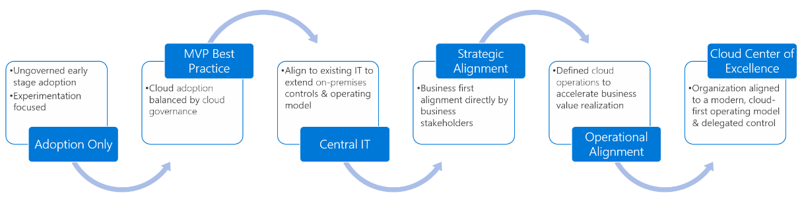
The overall process…

Slide 8
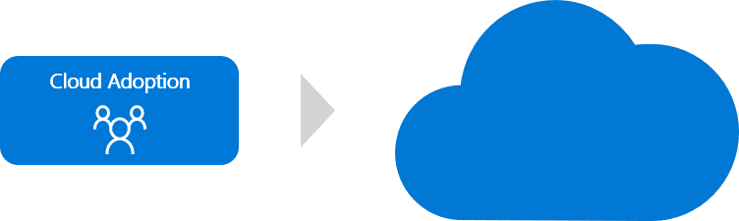
Cloud adoption team only

Slide 9
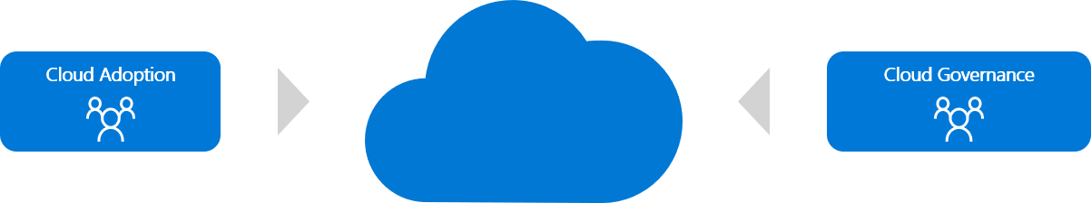
Best practice: MVP - Achieve balance

Slide 10
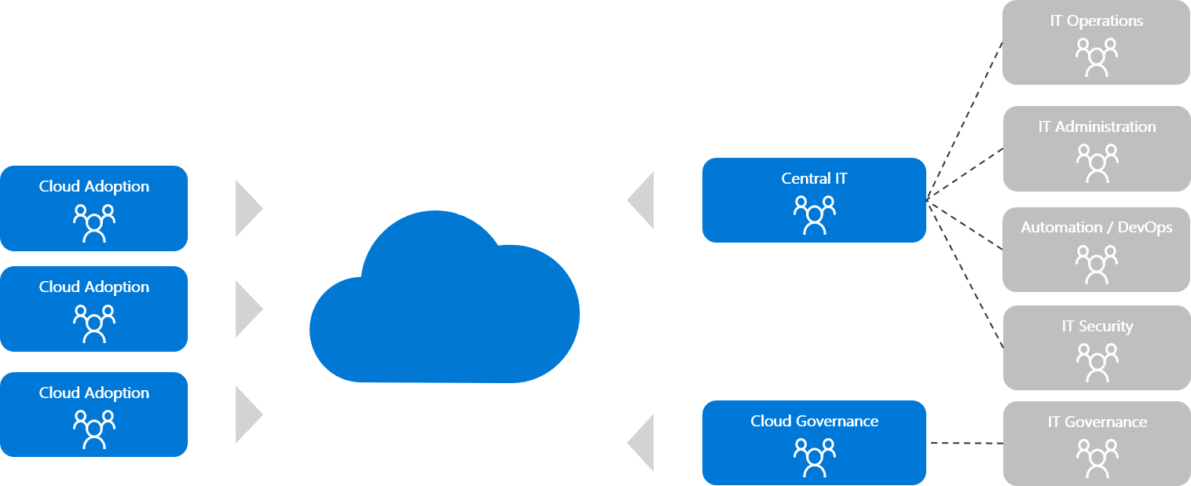
Next potential steps Central IT…

Slide 11
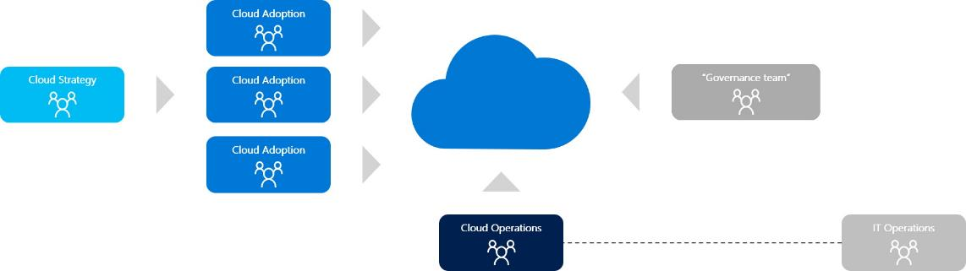
Strategic and operational alignment

Slide 12
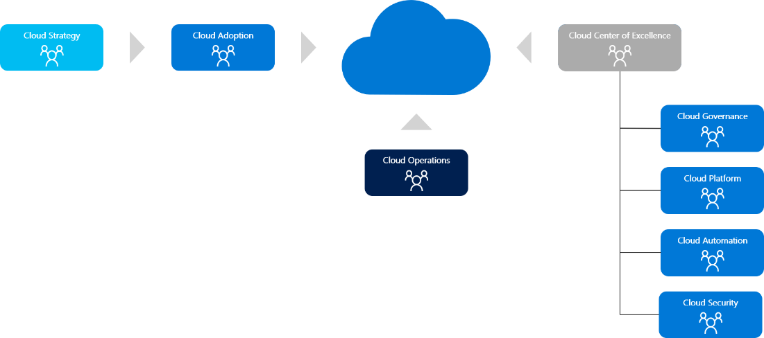
Cloud center of excellence

Slide 13
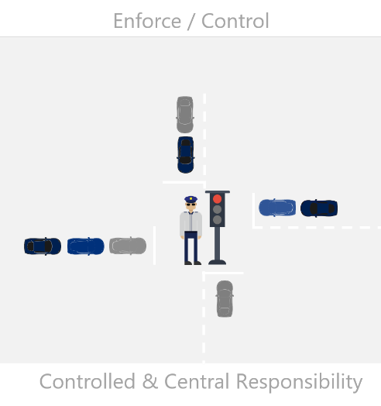
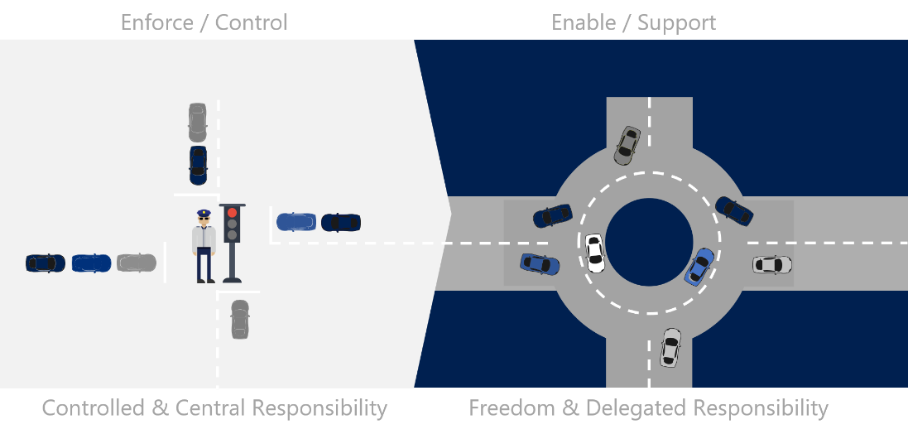
The idea behind…

Slide 14
Zentrale oder Dezentrale Verantwortung

Slide 15
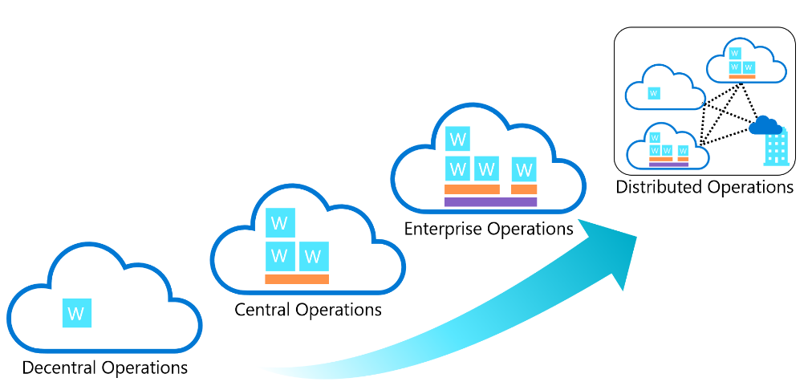
Compare common cloud operating models
Complexity

Slide 16
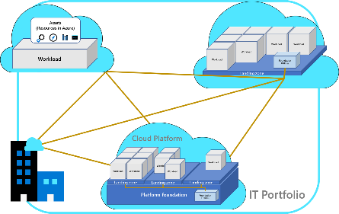
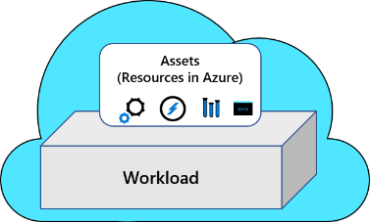
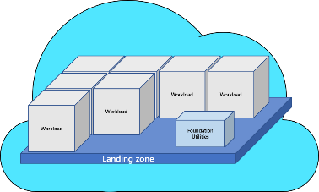
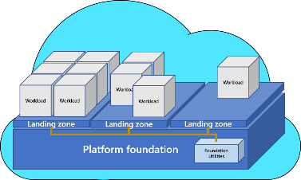
Compare…
Preferred cloud operating model
Decentralized operations
Distributed operations
Centralized operations
Enterprise operations
 | Decentralized ops | Centralized ops | Enterprise ops | Distributed ops
Starting point | Azure Well-Architected Framework (WAF) | Azure landing zones: start-small options | Azure landing zones: CAF enterprise-scale | Business alignment
Iterations | A focus on workloads allows the team to iterate within WAF. | The start-small option requires additional iteration on each methodology, but that can be done as cloud adoption efforts mature. | As illustrated by the reference implementations, future iterations typically focus on minor configuration additions. | Review the Azure landing zone implementation options to start with the option that best meets your operations baseline. Follow the iteration path defined in that option's design principles.

Slide 17
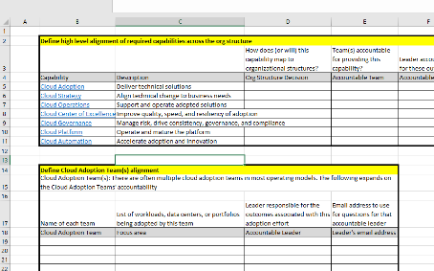
Tools & Referenz
Referenz https://docs.microsoft.com/en-us/azure/cloud-adoption-framework/organize/
Tool https://docs.microsoft.com/en-us/azure/cloud-adoption-framework/organize/raci-alignment#next-steps

